Slide 1
Centre of competence In Visual Computing Internship phase II presentation AI Self Driving Car
Under the guidance of Prof. Merin Meleet and Anisha B S
Team Members:
Vishweshwar bhat
Ram Abhinav

Slide 2
Contents
Introduction
Car Behaviour Cloning
Dataset Description
Data Preprocessing
Model Architecture
Hyper Parameter Tuning
Implementation
References

Slide 3
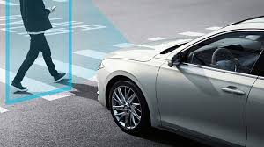
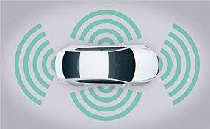
Introduction
Self Driving Cars are very common these days. With various tech. giants working in this field of research, autonomous mobility i.e. self-driving cars are no longer the talks of fiction. Various driving support systems are now available in market like lane assist, parking assist, etc. These features are called ADAS or Advanced Driver Assistance Systems. The cameras mounted on the front of the car i.e. on the hood of the car, are being used by various self-driving car engineers to implement these ADAS functions. Some functions include Road lane recognition, traffic signs detection, object or vehicle detection, and so on. The list is never ending. In this , various front facing cameras (center, left and right) are used to improve the driving behaviour of the self-driving cars and the model is trained in such a way that the car never goes out of the track despite of the road curvatures or sharp turns.

Slide 4
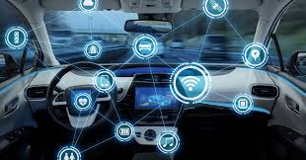
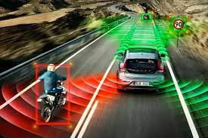
Car Behavior Cloning
Behavioral cloning is the process of replicating human behavior via visuomotor policies by means of machine learning algorithms. In recent years, several deep learning-based behavioral cloning approaches have been developed in the context of self-driving cars specifically based on the concept of transfer learning
The the goal of behavioral cloning is to collect data while exhibiting good behavior and then train a model to mimic that behavior with the collected data. While in a real-world setting this would involved mounting sensors on a car and driving around, in a simulator.

Slide 5
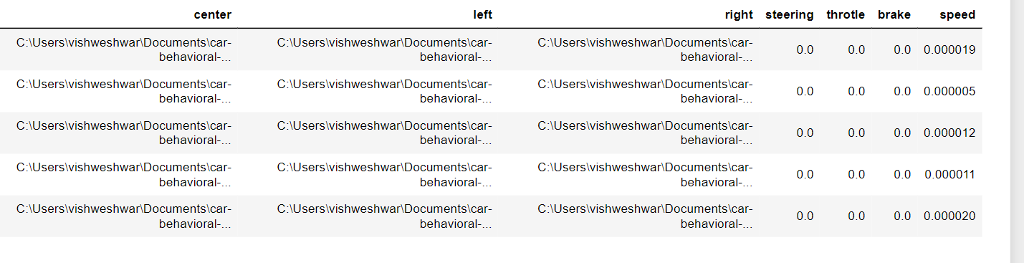
Dataset Description
Collected From the simulator
Consist of 7 columns i.e.
Path of the images from Center, Left and Right Camera
Steering Angle
Throttle
Brake
Speed
A look at Data Collected

Slide 6
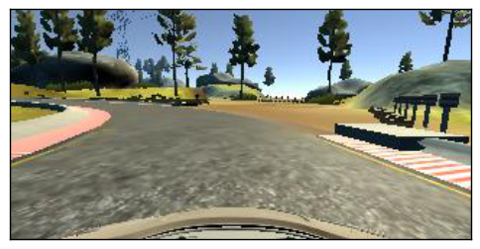
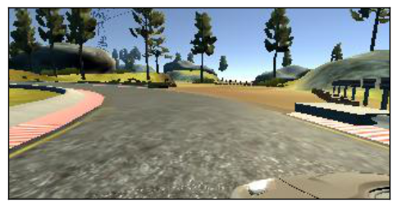
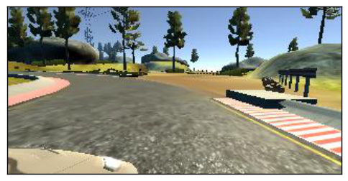
Sample Images
Image from center camera
Image from left camera
Image from right camera

Slide 7
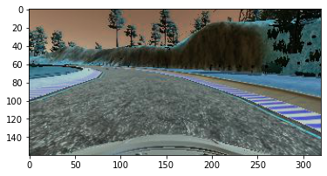
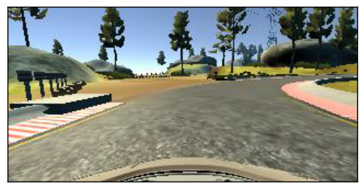
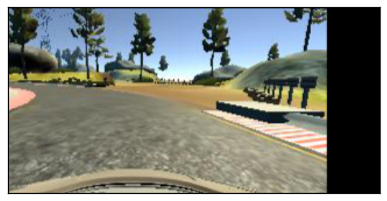
Data Preprocessing
Techniques
Cropping the Region of Interest (ROI)
Randomly Flipping the Image
Randomly shifting the image (translating)
Randomly changing the Brightness Of the Image
Converting RGB to YUV format
And Resizing the Image
Randomly Changing the Brightness
Randomly Flipping the image
Randomly Translating the image

Slide 8
Hyper Parameter Tuning using Keras Tuner
Hyper Parameters
N convolution Layers
N Kernel Size
Drop Out Ratio
Learning Rate
N No. of Convolution Kernel
N No. of Dense Input

Slide 9
Best Hyper Parameter So Far…!
N CNN layers:6
Kernel Size : 3 and 5
No. of Conv Kernel
Conv1 : 192 , Conv2 : 48, Conv3 : 72, Conv : 96, Conv : 40, Conv : 40
No. of Dense inputs
Dense1 : 64 Dense2:40 Dense:15
Learning Rate=0.001

Slide 10
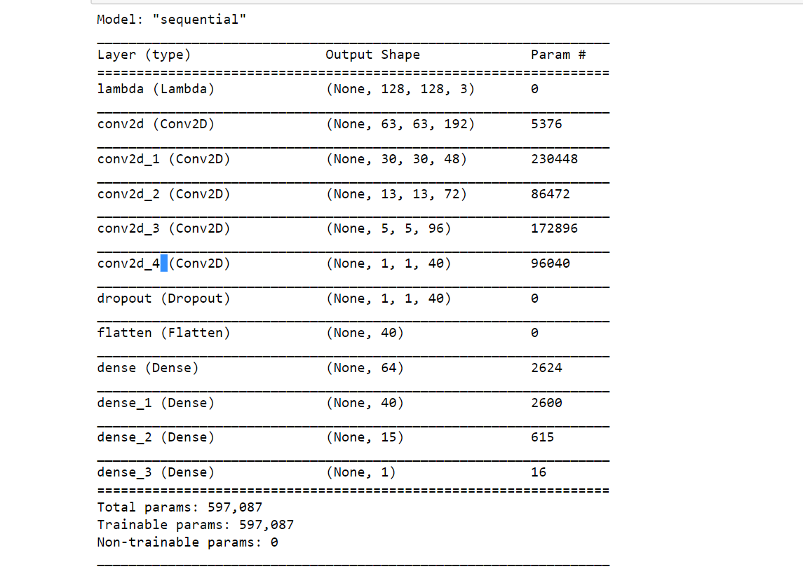
Model Architecture

Slide 11
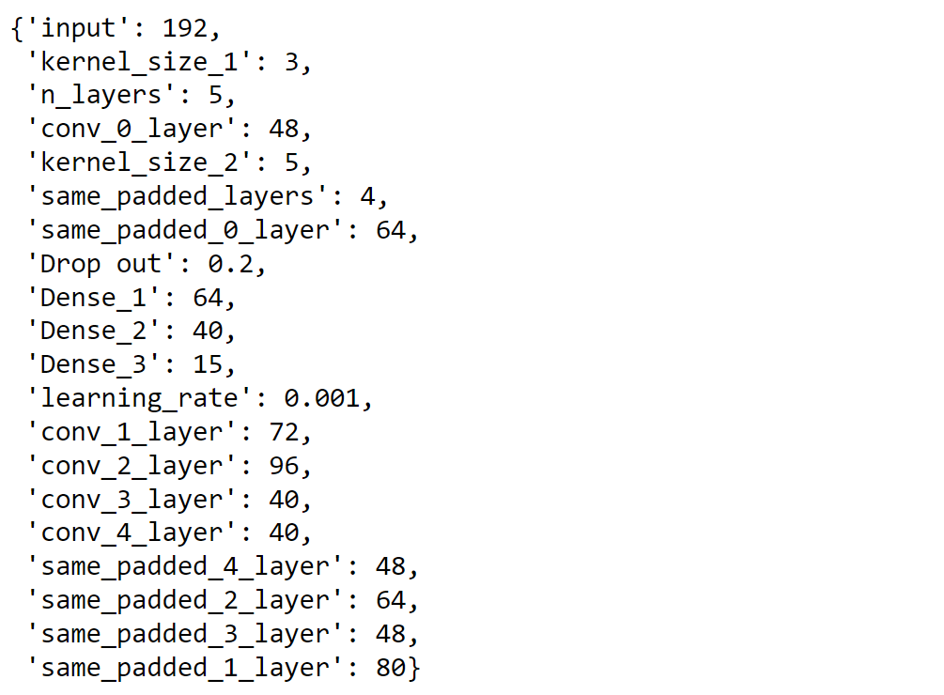
A Look At Best Hyper Parameter

Slide 12
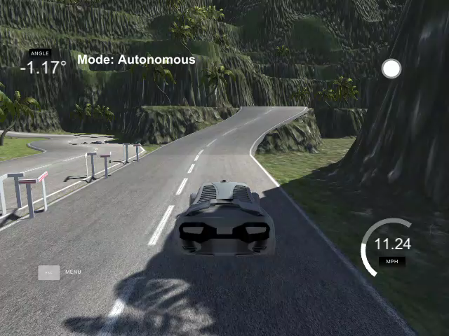
Demo of Deployment

Slide 13
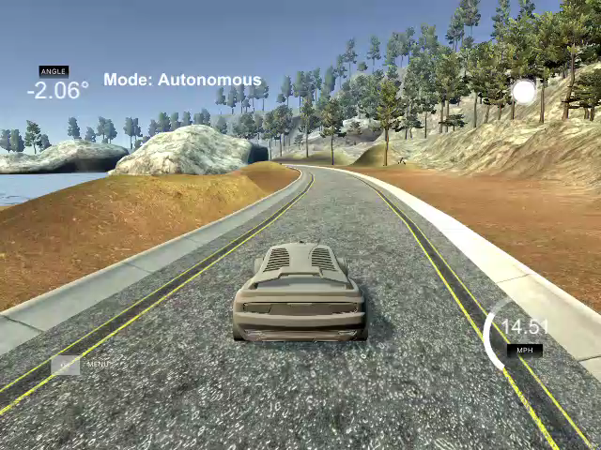
Demo of Deployment

Slide 14
References
[1] M. Bojarski, D. Del Testa, D. Dworakowski, B. Firner, B. Flepp, P. Goyal, L. D. Jackel, M. Monfort, U. Muller, J. Zhang, et al. End to end learning for self-driving cars. arXiv preprint arXiv:1604.07316, 2016.
[2] M. Bojarski, P. Yeres, A. Choromanska, K. Choromanski, B. Firner, L. Jackel, and U. Muller. Explaining how a deep neural network trained with end-to-end learning steers a car. arXiv preprint arXiv:1704.07911, 2017.
[3] Y. Wiseman and I. Grinberg, "When an Inescapable Accident of Autonomous Vehicles is Looming", International Journal of Control and Automation, Vol. 9(6), pp. 297-308, 2016.
[4] C. Farabet, C. Couprie, L. Najman, and Y. LeCun. Learning hierarchical features for scene labeling. IEEE transactions on pattern analysis and machine intelligence, 35(8):1915– 1929, 2013.
[5] I. Goodfellow, J. Pouget-Abadie, M. Mirza, B. Xu, D. Warde-Farley, S. Ozair, A. Courville, and Y. Bengio. Generative adversarial nets. In Advances in neural information processing systems, pages 2672–2680, 2014.
[6] K. He, X. Zhang, S. Ren, and J. Sun. Deep residual learning for image recognition. In Proceedings of the IEEE Conference on Computer Vision and Pattern Recognition, pages 770–778, 2016.

